Slide 1
SWE 4637: Cross-Platform Mobile Development
Functional Components, Third Party Components, and Navigation

Slide 2
Roadmap 🗺
Review of props & state
Learn about new components!
TextInput
ScrollView
FlatList
SectionList

Slide 3
Review: Props
Short for properties
Object argument with data and is passed into React components
Like arguments passed into a function!
Passed from parent to child

Slide 4
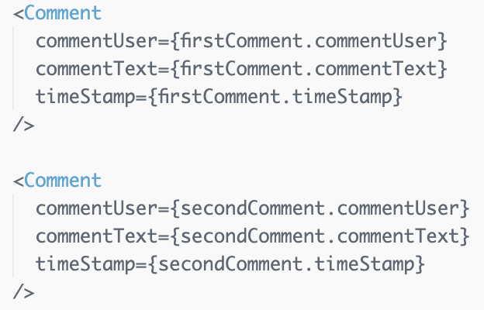
Review: Props

Slide 5
Review: State
Whereas props is an object that is passed to a component, state is managed within the component
The only way to update state variables is through setState
Using setState to update state causes a re-render of the screen (aka return function fires again)

Slide 6
Review: State
Deconstructing this line of code:
price is the name of our variable
setPrice is the function we call to update price
price starts with an initial value of 0
Adding a variable to a component’s state always follows this general pattern

Slide 7
Review: Props vs. State
Props are passed in by the parent and are fixed throughout the component’s lifetime
State is managed within the component and can be modified
For data that is going to change, use State!

Slide 8
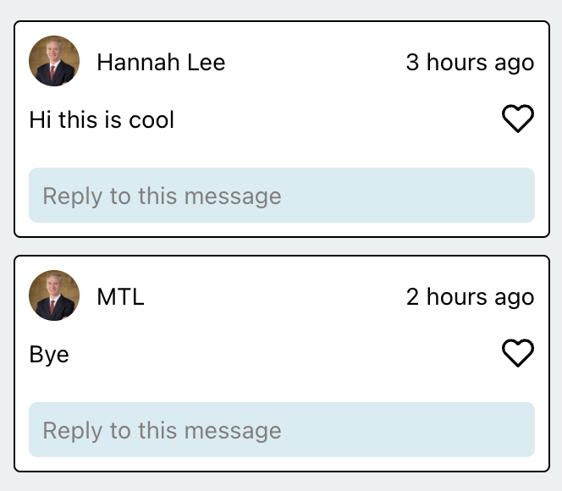
Demo
https://snack.expo.dev/@hannahlee/fun-stuff-starter

Slide 9
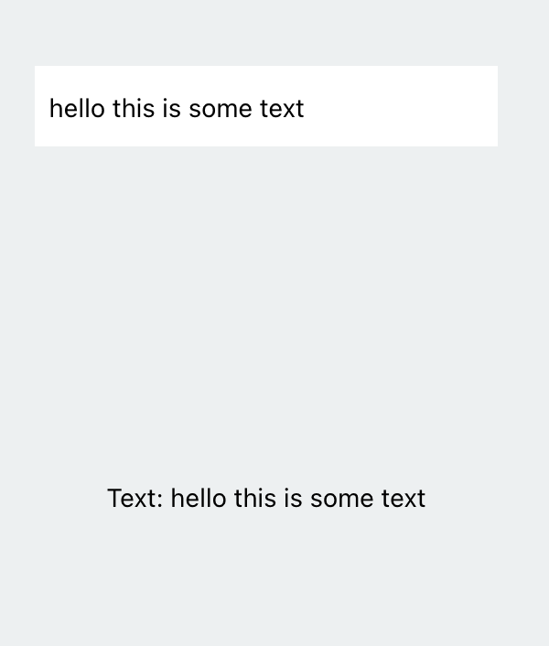
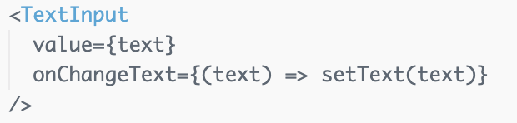
TextInput
Allows us to get text input from the user
Username/password log-in fields
Typing in a new to-do item
etc.
Two notable props:
value is the text that the textInput displays
onChangeText is called when the text is updated by the user
Demo: final product
Docs: https://reactnative.dev/docs/textinput

Slide 10
ScrollView
Like a View, but… scrollable!
Renders all the components within the ScrollView at once, even if they’re not currently displayed on the screen
This means slow performance and a lot of memory usage
Best to display a small number of things of limited size
Demo: follow-along / final product
Docs: https://reactnative.dev/docs/scrollview

Slide 11
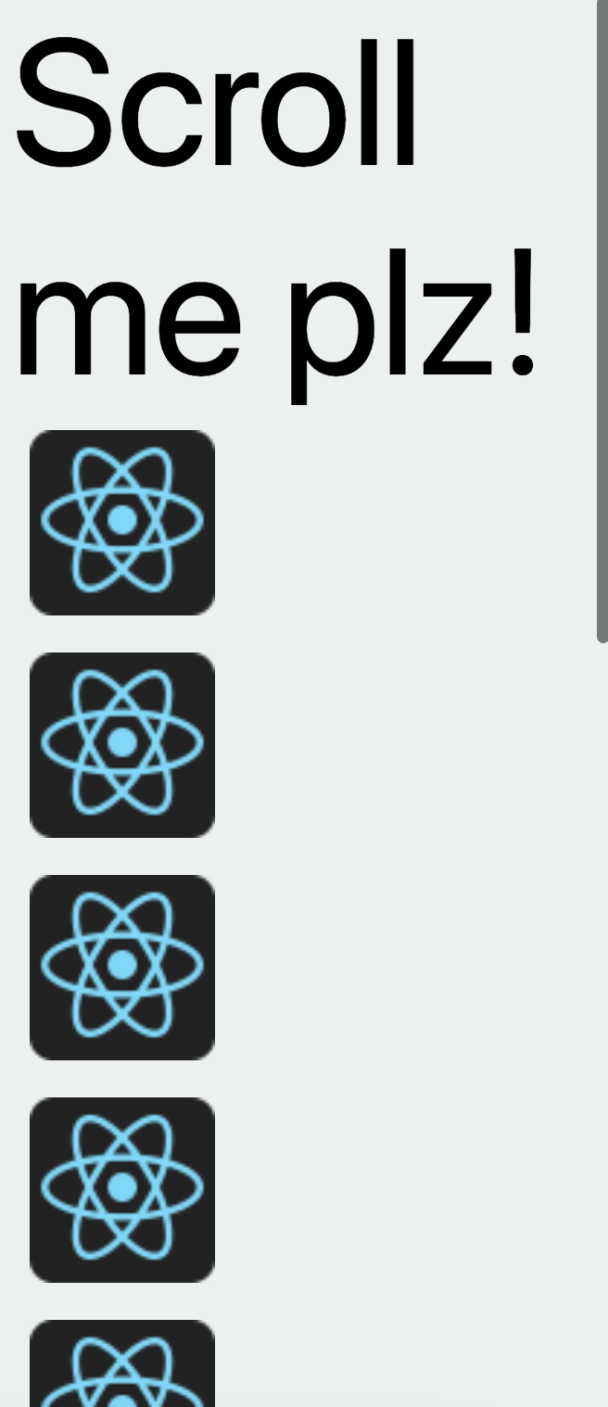
ScrollView
Like a View, but… scrollable!
Renders all the components within the ScrollView at once, even if they’re not currently displayed on the screen
This means slow performance and a lot of memory usage
Best to display a small number of things of limited size
Demo: follow-along / final product
Docs: https://reactnative.dev/docs/scrollview
more content down here!

Slide 12
React Native Lists
Allow us to present lists of data
Only renders the elements currently visible on the screen, not all at once = better than ScrollView for long lists ✅
Built-in scrolling
Today we will learn about FlatList and SectionList

Slide 13
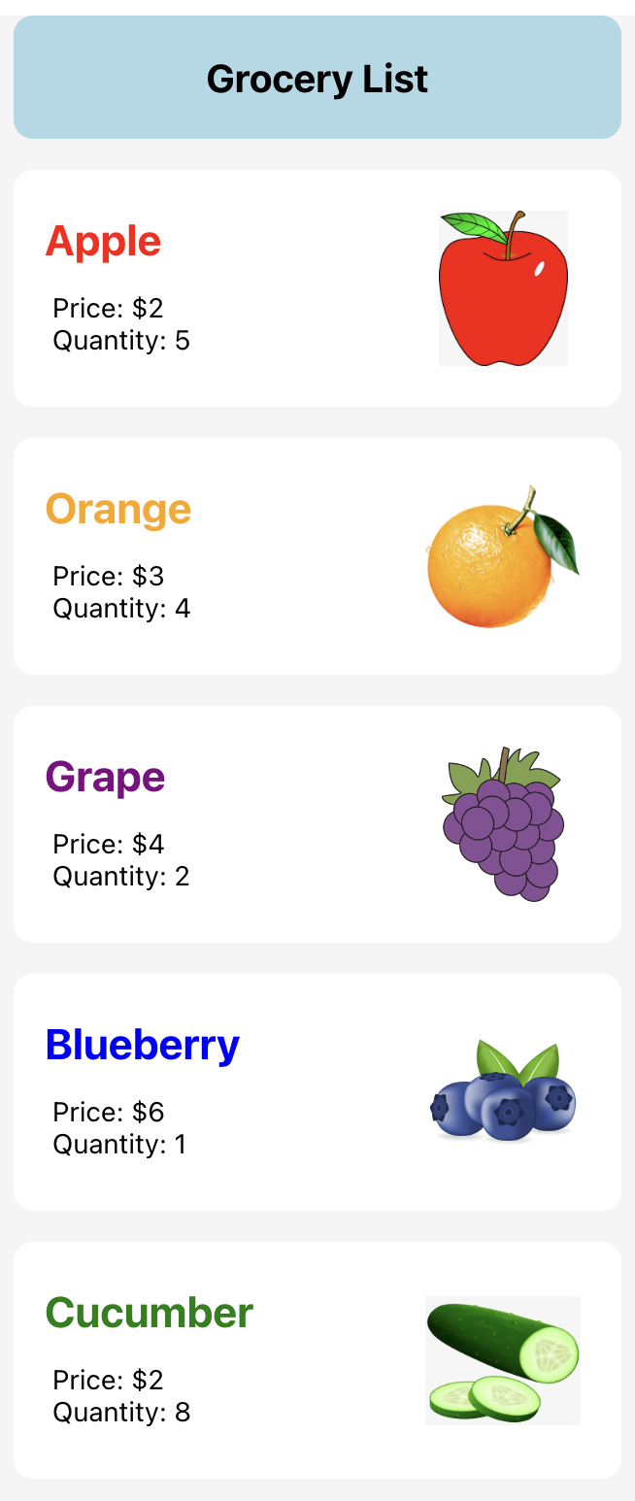
FlatList
Fully cross-platform, offers header/footer support, pull to refresh, scrollable
Three notable props:
data is the array of data that the list displays
renderItem is a function that takes in an item from the data and renders it
this is where we specify the UI layout for each element in the list
keyExtractor is a function that returns a unique key for each element in the list
very important & common cause of errors!
Demo: follow-along / final product
Docs: https://reactnative.dev/docs/flatlist

Slide 14
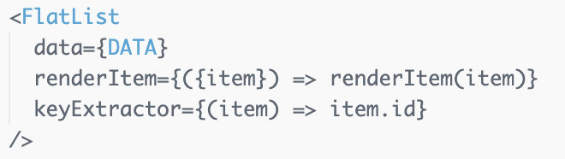
FlatList
Fully cross-platform, offers header/footer support, pull to refresh, scrollable
Three notable props:
data is the array of data that the list displays
renderItem is a function that takes in an item from the data and renders it
this is where we specify the UI layout for each element in the list
keyExtractor is a function that returns a unique key for each element in the list
very important & common cause of errors!
Demo: follow-along / final product
Docs: https://reactnative.dev/docs/flatlist

Slide 15
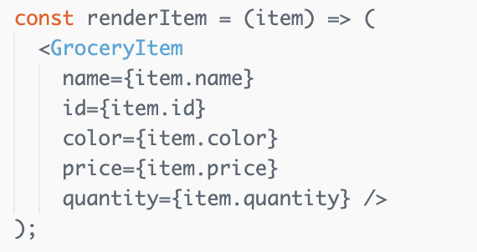
FlatList
each of these rows is a GroceryItem component, rendered using renderItem
Docs: https://reactnative.dev/docs/flatlist

Slide 16
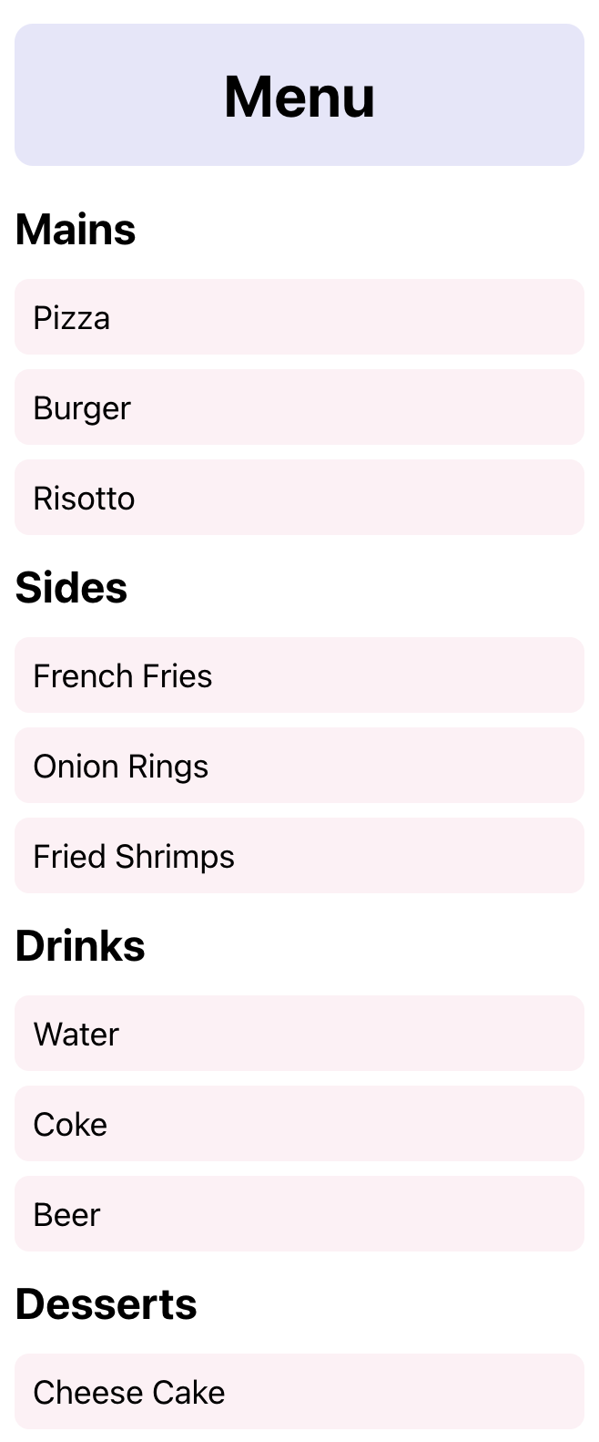
SectionList
Like FlatList, but with sections!
Four notable props:
(same as FlatList)
renderItem is a function that takes in an item from the data and renders it
keyExtractor is a function that returns a unique key for each element in the list
(new)
sections is an array that maps each section to the data within it
renderSectionHeader lets you render the layout for each section header
Demo: follow-along / final product
Docs: https://reactnative.dev/docs/sectionlist

Slide 17
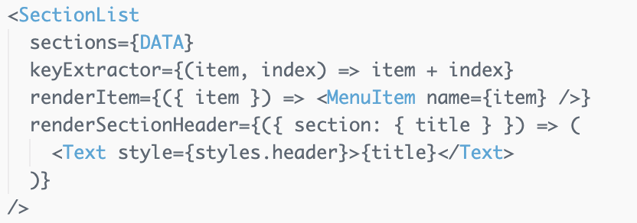
SectionList
Like FlatList, but with sections!
Four notable props:
(same as FlatList)
renderItem is a function that takes in an item from the data and renders it
keyExtractor is a function that returns a unique key for each element in the list
(new)
sections is an array that maps each section to the data within it
renderSectionHeader lets you render the layout for each section header
Demo: follow-along / final product
Docs: https://reactnative.dev/docs/sectionlist

Slide 18


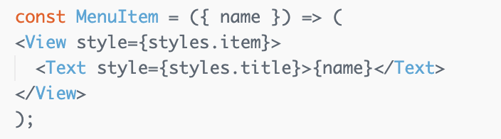
SectionList
each of these rows is a MenuItem component, rendered using renderItem
each of these rows is a section header, rendered using renderSectionHeader
Docs: https://reactnative.dev/docs/sectionlist

Slide 19
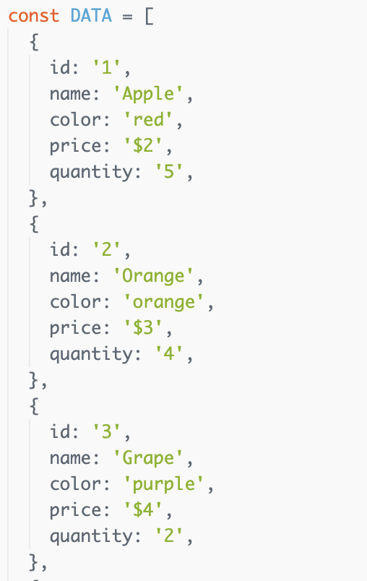
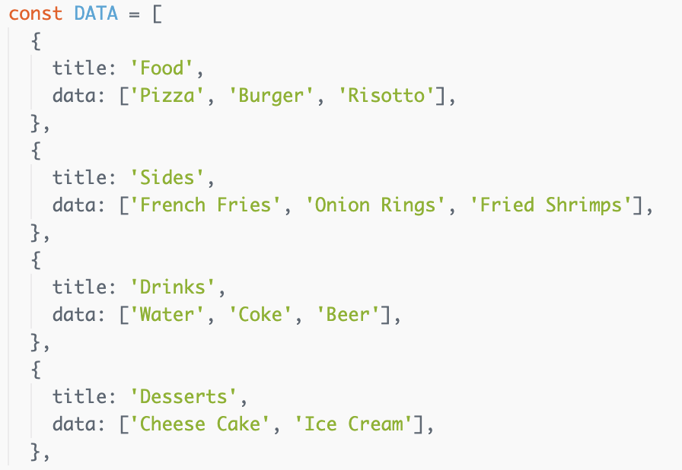
FlatList vs. SectionList Data
FlatList – no sections, just items
SectionList – section titles map to arrays of items

Slide 20
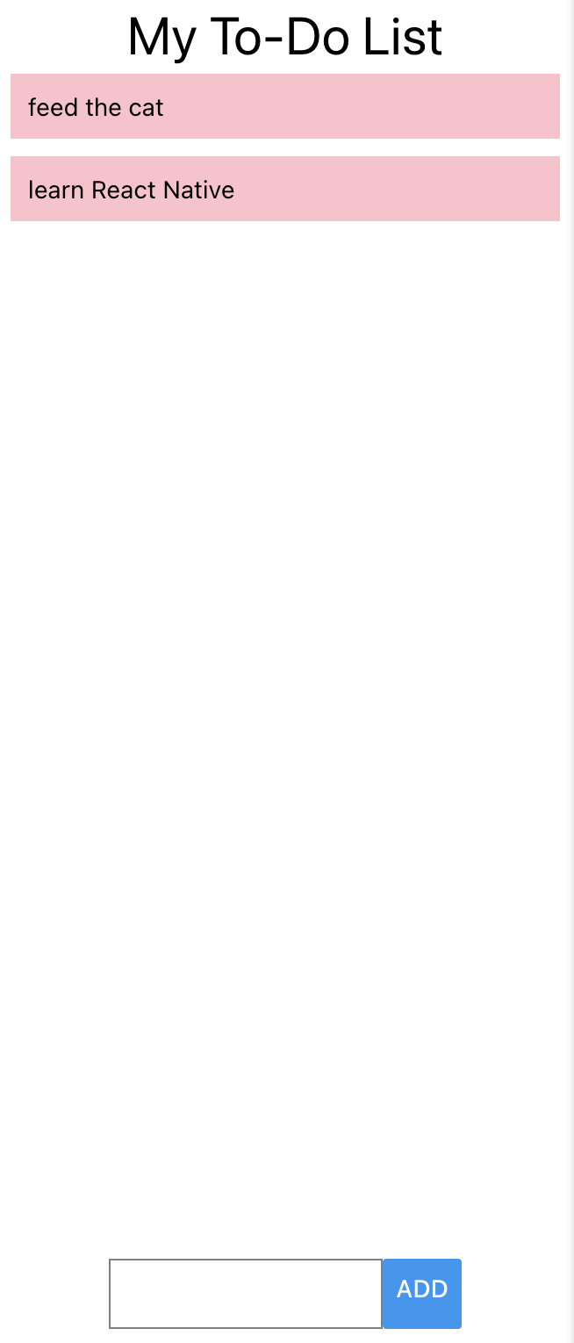
Put it all together!
To-do list app
Starter code:
https://snack.expo.dev/@nadout/happy-popcorn
Solution – don’t look until you’ve tried it yourself :)

Slide 21
Components
React Native core components (View, Text, Image, FlatList, etc.)
There are more components that we haven’t covered in lecture, so definitely go through this list at some point to check out what other components you can use!
e.g. ImageBackground, TouchableOpacity, ActivityIndicator, Switch
Custom components (e.g. GroceryItem from today)
Third-party components → now!

Slide 22
Third-Party Components
No need to re-invent the wheel
Developers have already implemented many different libraries with components / interactions you might want to include in your app 🤩
A few examples:
Calendar
Chat
Swiping
Maps
Custom UI components
Don’t be shy about using third-party components – they will make your life a lot easier! 🤗

Slide 23
Third-Party Components
Where can we find third-party components to use in our apps?
Expo SDK (see list on the left sidebar)
React Native Directory
npm registry
Some of my favs:
React Native Paper
React Native Elements
Useful link: https://docs.expo.dev/workflow/using-libraries/

Slide 24
Third-Party Components
Word of warning: Not all libraries you find online will be compatible with React Native and/or Expo ⚠️
On React Native Directory, check for the ✔️ Expo Go flag (link above is already filtered)
Otherwise, check the GitHub repo for the library for the following:
Is there an ios/ or android/ directory?
Does the README mention linking (react-native link)?
Is it built specifically for Node.js, the web, electron, or some other platform?
If you answered yes to any of these, the library may be incompatible with Expo.
You can always try installing the library and using it to confirm whether or not it is compatible!
Useful link: https://docs.expo.dev/workflow/using-libraries/

Slide 25
Third-Party Components
Use npx expo install as opposed to npm install or yarn add
This command allows Expo to pick a compatible version of the library and will also warn you about any known incompatibilities!
Generally fine to use even if installation instructions say npm install (npx expo install is basically just npm install under the hood with some extra checks)
Make sure to run installation commands in the project directory!
Follow any other commands outlined in the README for setup
✨ cd [APP-DIRECTORY]
✨ npx expo install [LIBRARY-NAME]

Slide 26
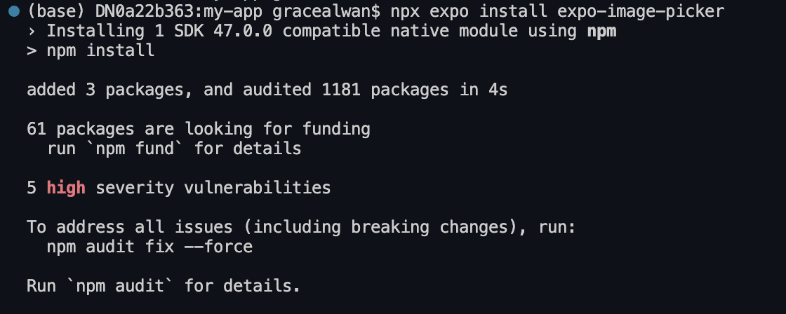
Third-Party Components
Example output of installing the expo-image-picker library

Slide 27
Third-Party Components
Example output of installing the expo-image-picker library

Slide 28
Demo! 🦍
https://github.com/gracealwan/thirdPartyComponents

Slide 29
Demo – Icons
@expo/vector-icons library is installed by default in projects created using npx expo init icon-demo
Browse icons on https://icons.expo.fyi/
Follow directions to display icon component in your app
Demo Code
Useful link: https://docs.expo.dev/guides/icons/

Slide 30
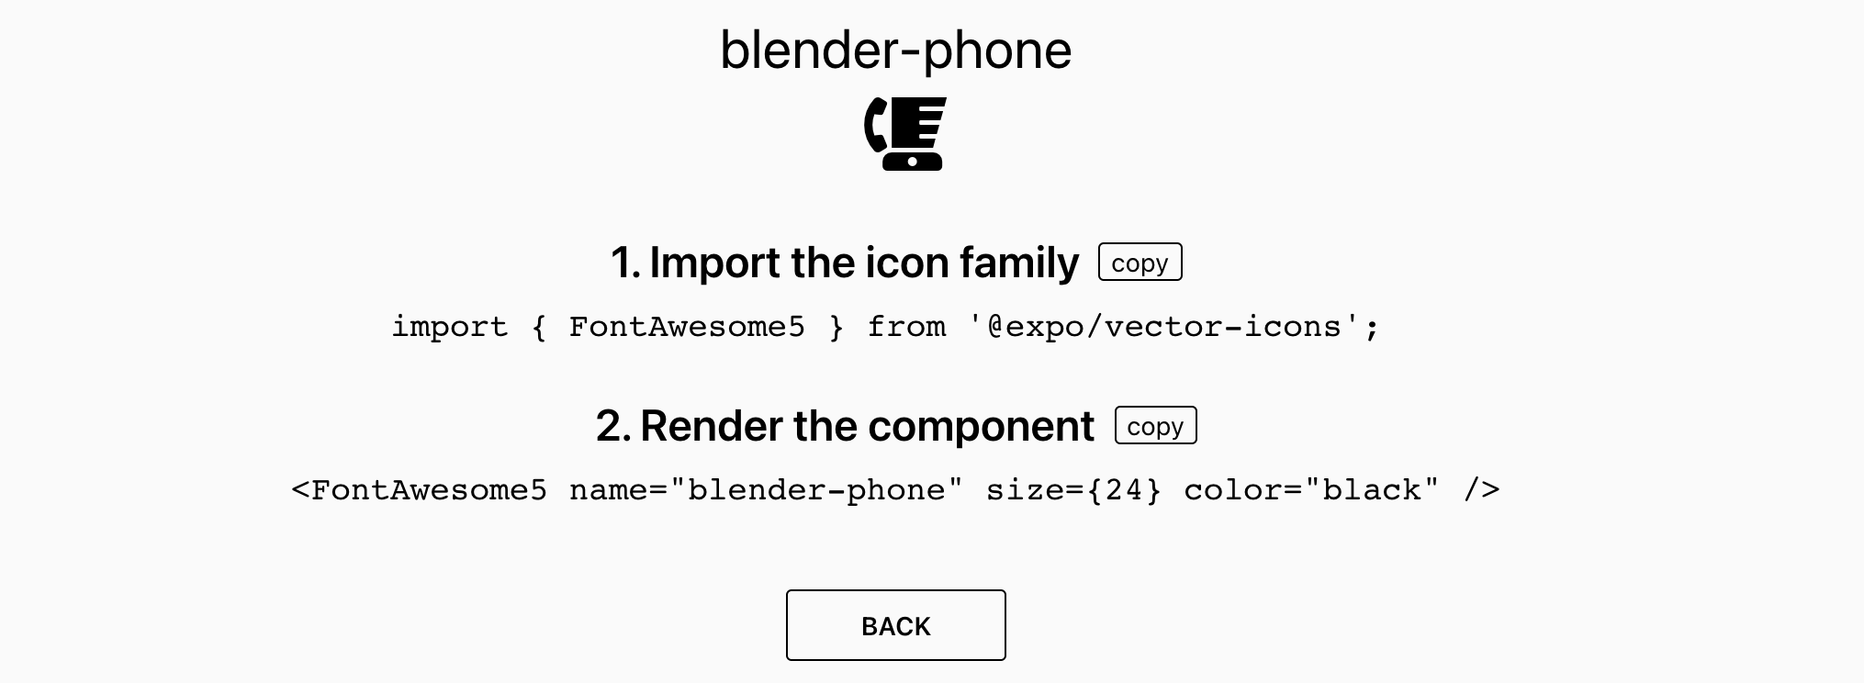
Demo – Icons
Demo Code
Useful link: https://docs.expo.dev/guides/icons/

Slide 31
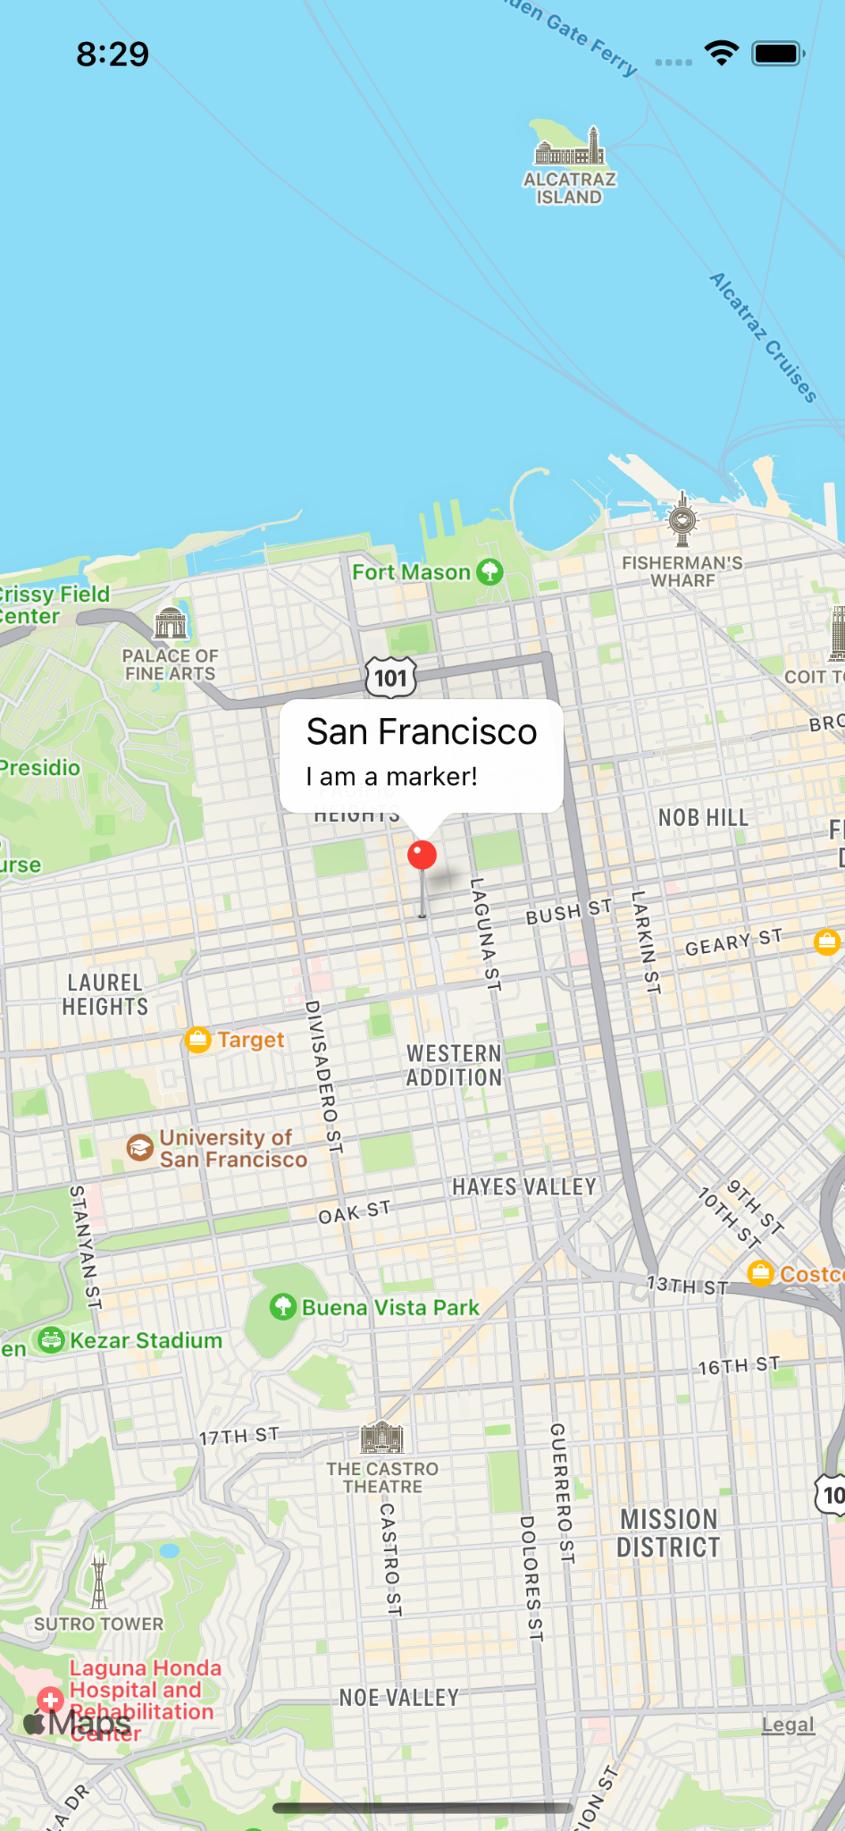
Demo – react-native-maps
Demo Code
React Native Map components for iOS + Android
Install using npx expo install react-native-maps
Can use Apple Maps or Google Maps for iOS, must use Google Maps for Android
Need a Google API key to use Google Maps
MapView, Marker, and other components
GitHub link: https://github.com/react-native-maps/react-native-maps

